Slide 1

SENSORS

Slide 2

What is a Sensor?
1) A sensor is an input device that provides an output (signal) with respect to a specific physical quantity (input). The term “input device” in the definition of a Sensor means that it is part of a bigger system that provides input to the main control system (like a Processor or a Microcontroller).
2) Another unique definition of a Sensor is as follows: It is a device that converts signals from one energy domain to an electrical domain.

Slide 3

Classification of Sensors
There are two types of Sensors.
1) Analog Sensors: It produce an analog output i.e. a continuous output signal with respect to the quantity being measured.
2) Digital Sensors: It work with discrete or digital data. The data in digital sensors, which are used for conversion and transmission, is digital in nature.

Slide 4
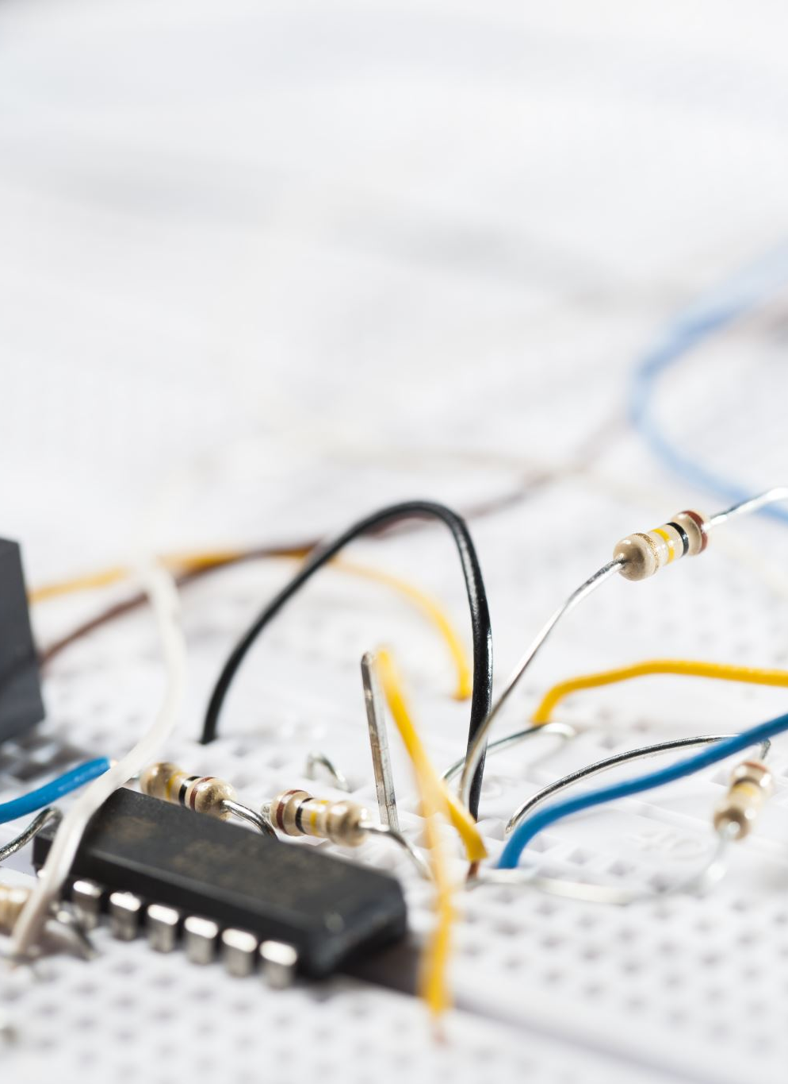
Different Examples of Sensors
All these sensors are used for measuring one of the physical properties like Temperature, Resistance, Capacitance, Conduction, Heat Transfer, etc.
Joystick
Flame Sensor
RGB LED
Heartbeat Sensor
Light Cup

Slide 5
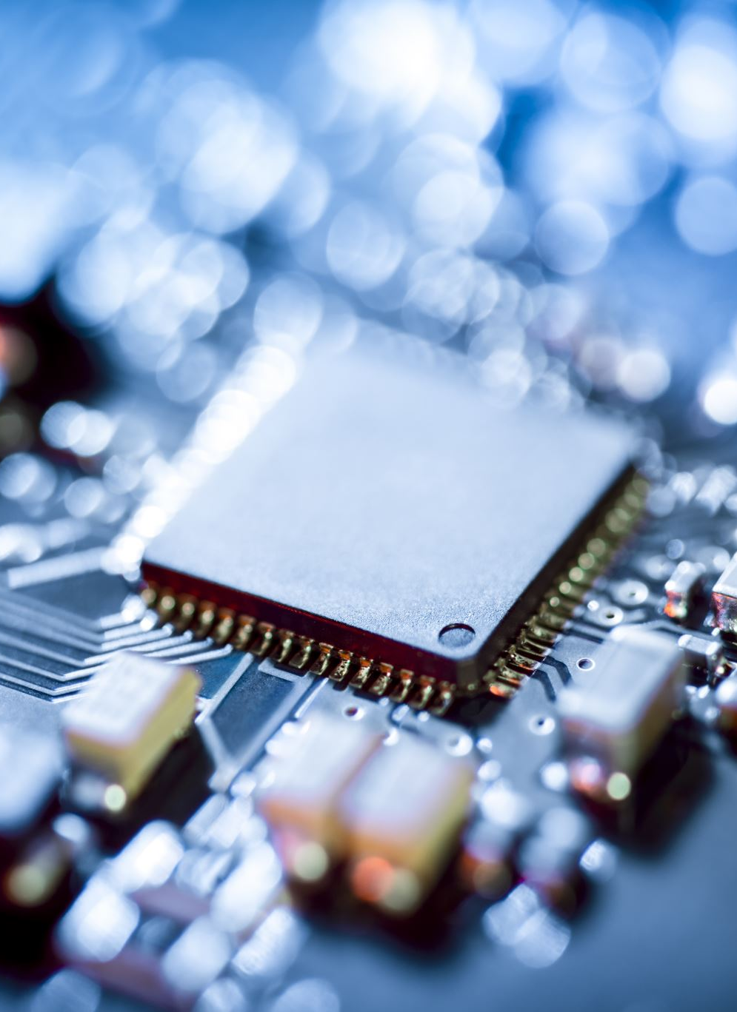
Hall Magnetic Sensor
Relay
Linear Hall Sensor
SMD RGB
7 Color Flash
Tilt Switch
Temperature Sensor
Big Sound Sensor
Touch Sensor
Two-Color LED
Laser Emitter
Ball Switch
Analog Temperature Sensor

Slide 6
Small Sound Sensor
Digital Temperature Sensor
Two-Color LED (small)
Button
Photoresistor
IR Emission
Tracking Sensor
Buzzer
Reed Switch
Shock Sensor
Temperature And Humidity Sensor
IR Receiver
Avoidance Sensor

Slide 7
Passive Buzzer
Mini Reed
Rotary Encoders
Analog Hall Sensor
Tap Module
Light Blocking
Proximity Sensor
Accelerometer
IR Sensor (Infrared Sensor)
Pressure Sensor
Ultrasonic Sensor
Smoke, Gas, and Alcohol Sensor
Color Sensor
Flow and Level Sensor
Gyroscope Sensor
Optical Sensor

